Slide 1

Patio 2
Patio 2 Block Diagram
Throw the table tennis ball into the basket🗑️
Recognize the arrow with OpenMV⬆️➡️⬅️
Travel to the release point
🚗
Travel to the communication area 🚗
Message with the laptop
💻
🛑Stop
with cobbled road🪨

Slide 2
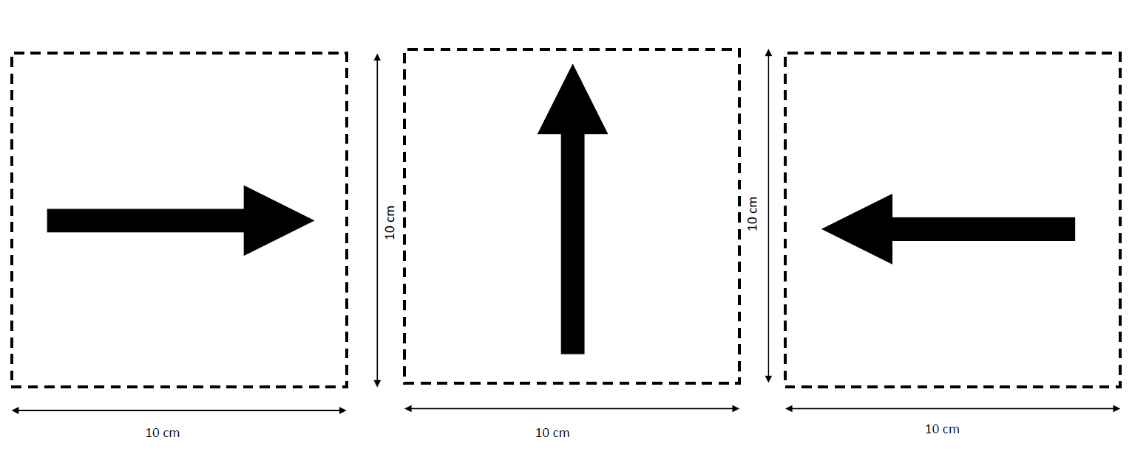
Patio 2
Problems in Recognition
Throw the table tennis ball into the basket🗑️
Recognize the arrow with OpenMV⬆️➡️⬅️
Travel to the release point
🚗
Travel to the communication area 🚗
Message with the laptop
💻
🛑Stop
with cobbled road🪨

Slide 3
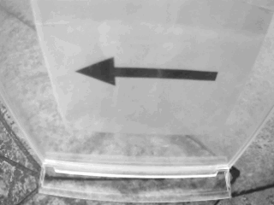
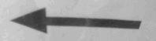
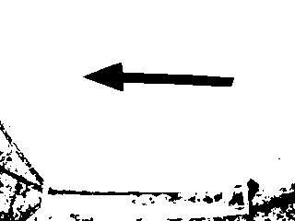
Patio 2
Change the recognition algorithm
Interception algorithm
Binary algorithm

Slide 4
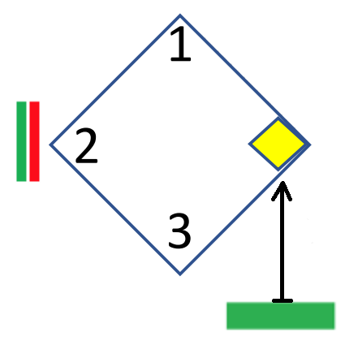
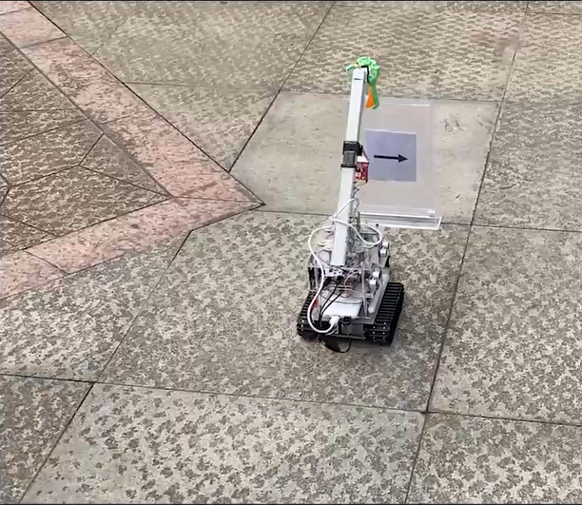
Patio 2
Set time delay
Set the Openmv delay to ensure the correctness of communication transmission
Increase the times of recognition to ensure the correctness of recognition

Slide 5
Patio 2
Problems in Traveling
Throw the table tennis ball into the basket🗑️
Recognize the arrow with OpenMV⬆️➡️⬅️
Travel to the release point
🚗
Travel to the communication area 🚗
Message with the laptop
💻
🛑Stop
with cobbled road🪨

Slide 6
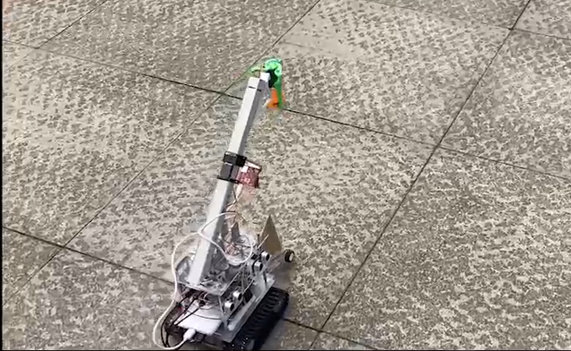
Patio 2
Simply go forward?
Go forward with the assist of gyroscope and accelerometer ✅

Slide 7
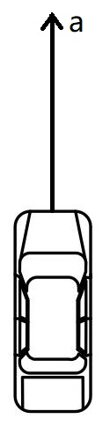
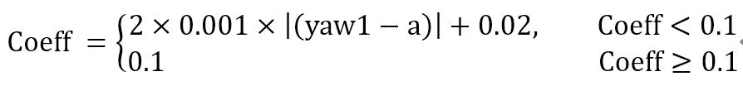
Patio 2
a: The orientation coordinate value
yaw1: The real-time orientation coordinates
Coeff: The speed difference
Stay still to obtain the orientation coordinate a
yaw1
a
a
yaw1
Adjusting the direction while moving forward
Rotate faster
(Add Coeff to the Pwmout)
Rotate slower
(Minus Coeff to the Pwmout)
Rotate faster
(Add Coeff to the Pwmout)

Slide 8
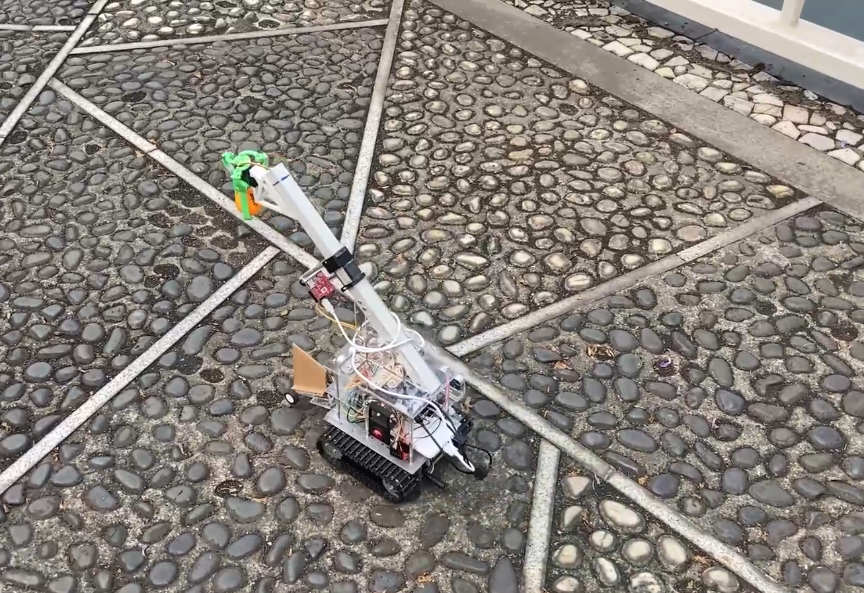
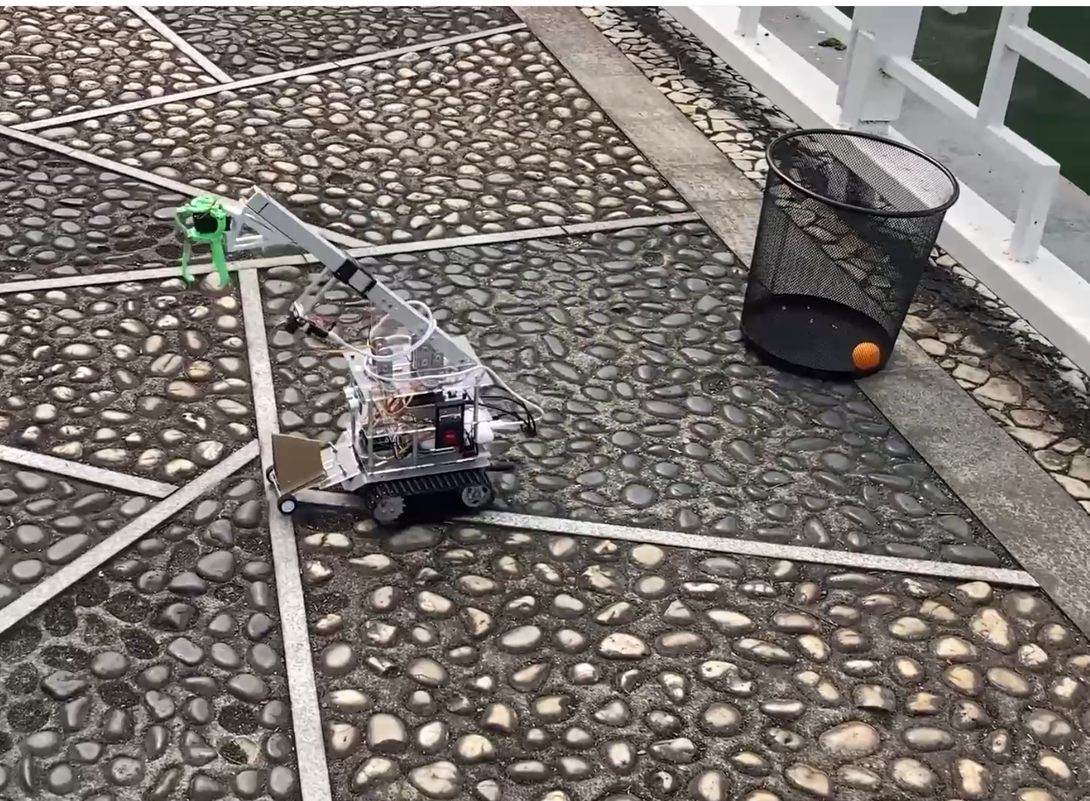
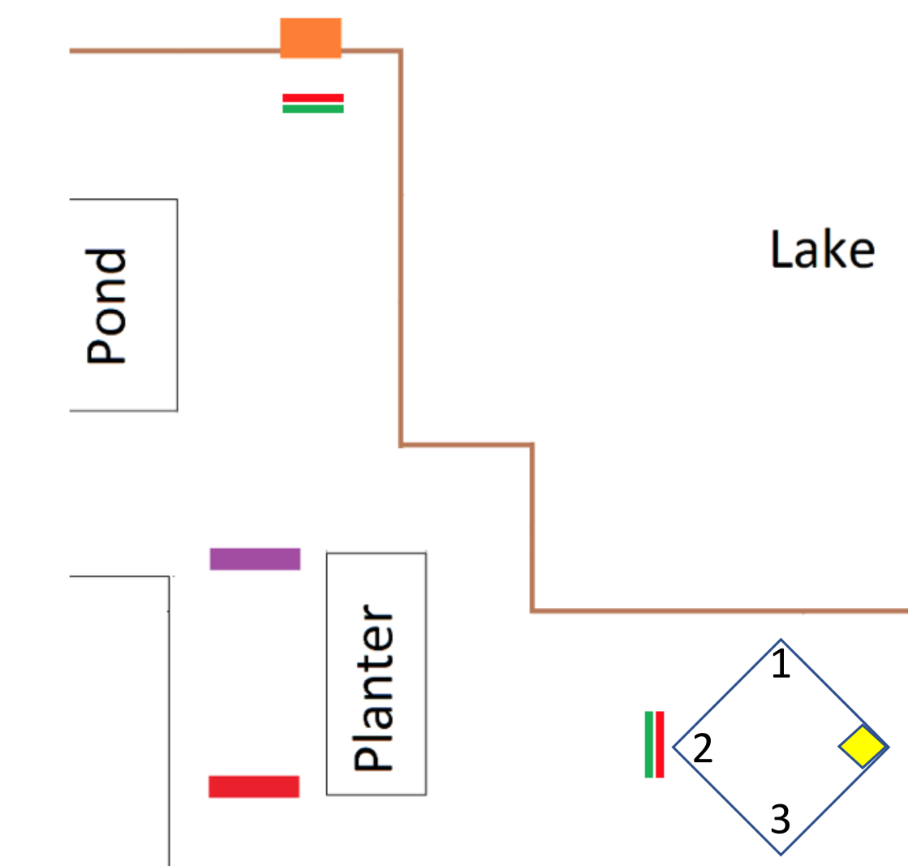
Patio 2
Just go forward with the assist of gyroscope and accelerometer🚗
Walking on the cobbled road🪨
Initial route
Simplified route

